Slide 1
My Story of Depression
3

Slide 2
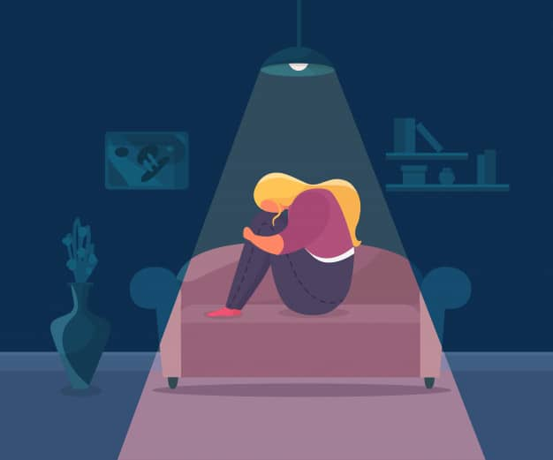

Slide 3
Symptoms of Depression
4

Slide 4
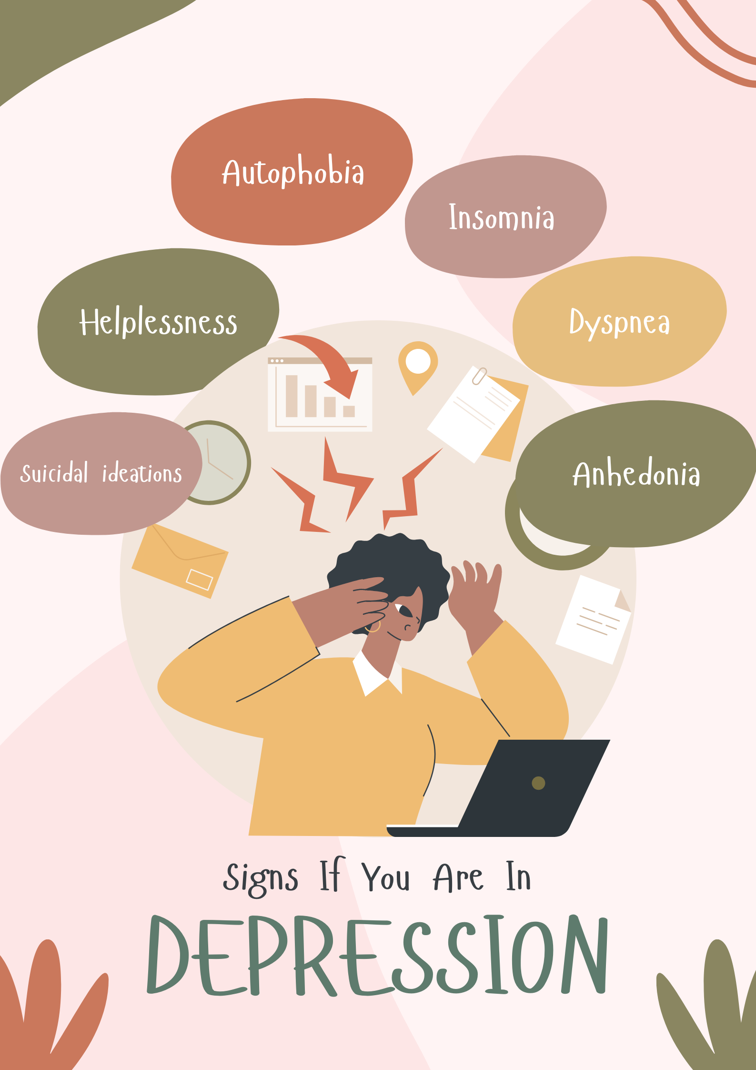

Slide 5
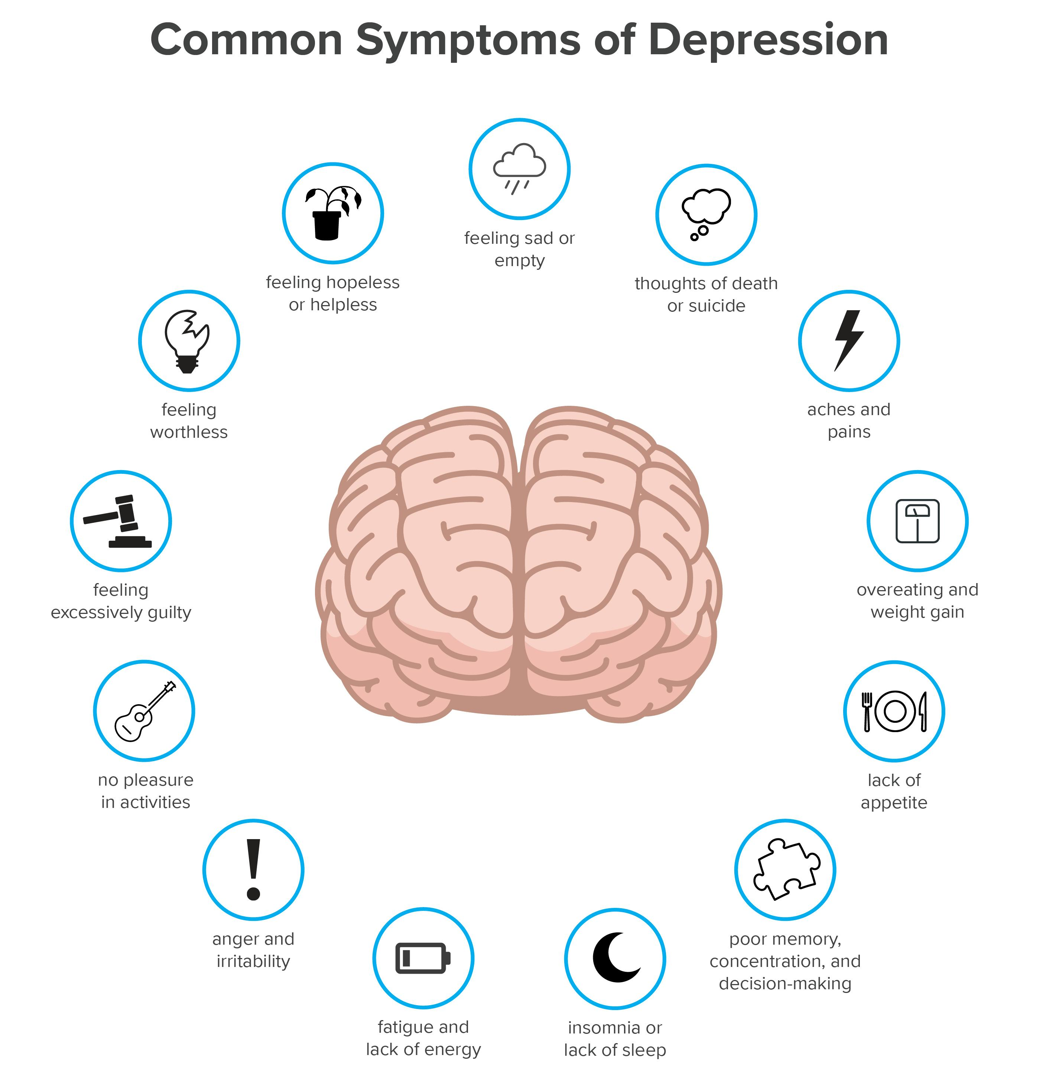

Slide 6
Causes of Depression
5

Slide 7
